Slide 1
Welcome to
Herons
Class

Slide 2
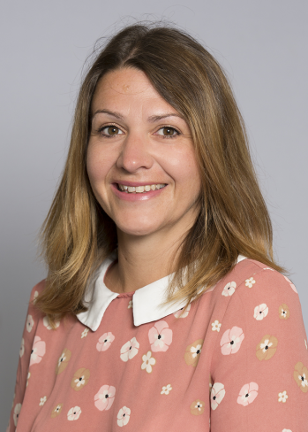
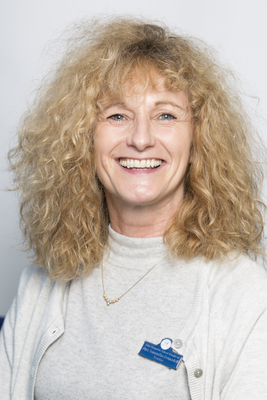
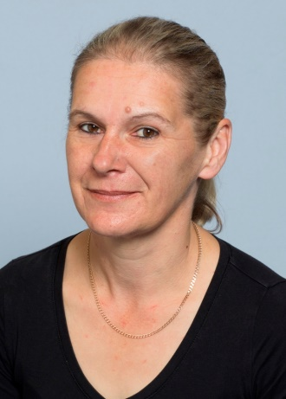
We are:
Mrs Bowman
Mrs Grimsdell
and
Mrs Wilton

Slide 3
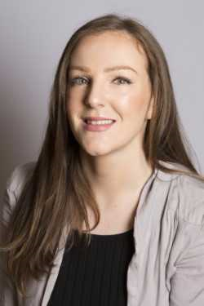
We are:
Mrs Morgan &
Mrs Wheeler

Slide 4
Topics
Gobblefunk
This will include a trip- more details to follow soon!

Slide 5
Book Changing
Tuesdays
and
Fridays.

Slide 6
Home/school Diary
Please sign the diary when
you have heard your child
read.
It can be used to
communicate messages.

Slide 7
Home/school Diary
The smiley faces are for
your child to complete
daily to reflect their day
in school.
Please sign the diary
each week, we will also
sign them weekly.

Slide 8
Homework
Little and often!
Please encourage your
child to read at home on
a daily basis for about 10 minutes.
Practise key words and
spellings regularly.
Homework will
be set fortnightly

Slide 9
Spellings
There will be spellings set every week.
Please help your child to learn these words.
They will be tested on a Friday. Please ensure they keep their spelling book in their book bag.

Slide 10
P.E.
Monday
and Wednesday
Please ensure your child
has appropriate kit
and correctly fitting
plimsolls or trainers,
all clearly named.
Long hair tied back and
earrings taped or
removed that day.

Slide 11
Jumpers and Cardigans!
Please ensure ALL jumpers and cardigans are named.

Slide 12
Holidays
Year 2 is a very
busy year. It is the final
year of Key Stage 1 and
we assess the children
regularly throughout the
year.
Unless there are
exceptional circumstances
please do not take your
child out of school during
term time.

Slide 13
SATs
Near the end of Y2 your
child will be involved in
statutory assessment
(SATs)
More information
about SATs later
in the year.

Slide 14
Water
Your child must bring
water in a named bottle
to keep in the classroom every day.
We do not have a water fountain!
Water bottles can be
bought from the school
office.

Slide 15
5
Independence
It is lovely to see so
many children entering
the classroom
independently
in the mornings.
Collection from
school
Please let the school know
of any changes to the
collection of your child.

Slide 16
Contact numbers
Please inform the
school if your
contact numbers
change.

Slide 17
Medical
Please inform the
school if there are any medical changes we might
need to know about. Also please ensure we have spare, in-date epipens/inhalers at school.

Slide 18
Finally
Please do not hesitate
to speak to any of us if you have
any queries or you
can leave a message
with any of the adults.
Thank you
for coming.

