Slide 1
Reading - helping you to help us
We aim to make our school the best,
A place of discovery and success
Caring, sharing, taking turns
We learn to love, we love to learn

Slide 2
Reading - helping you to help us
Question | Number of respondents | Number who strongly agree or agree | Number who disagree or strongly disagree | Number who don’t know | Percentage who strongly agree or agree
My awareness of how to help my child learn is enhanced through information given by the school – meetings, curriculum evenings and written information | 103 | 102 | 1 | 0 | 99%

Slide 3
Reading - helping you to help us
What are we required to teach?
How do we teach children to read and decode words?
What are the skills that children need to read fluently?
How can parents support their child’s reading development?

Slide 4
Reading - helping you to help us

Slide 5
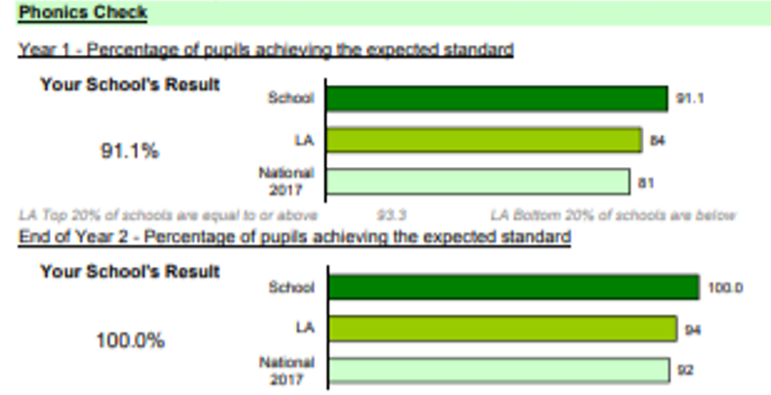
Reading - helping you to help us

Slide 6
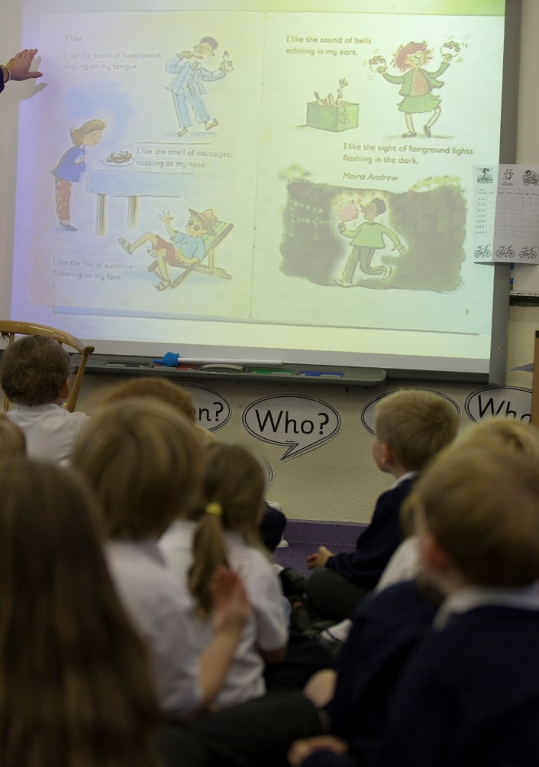
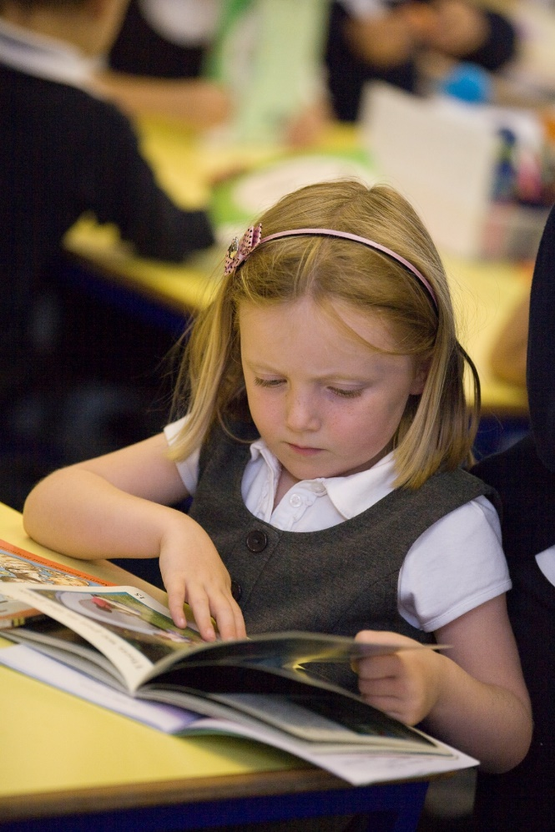
Reading - helping you to help us

Slide 7
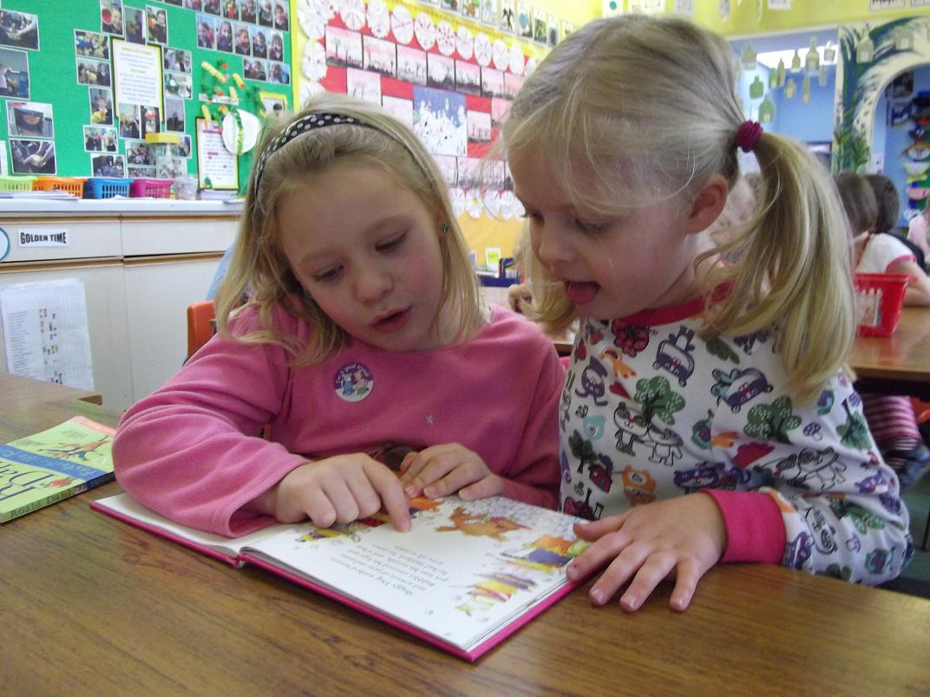
Reading - helping you to help us

Slide 8
Reading - helping you to help us
An enjoyment of books
An interest in stories/rhymes
A love of reading
Shared responsibility

Slide 9
Reading - helping you to help us

Slide 10
Sullivan & Brown, Social inequalities in cognitive scores at age 16: The role of reading
‘Children who read for pleasure are likely to do significantly better at school than their peers, making greater progress in mathematics, development of vocabulary and spelling’

Slide 11
Reading - helping you to help us
What should school/home do?

Slide 12
Reading - helping you to help us
Mechanics of reading
Attainment and progress

Slide 13
Reading - helping you to help us
What could school/home do?

Slide 14
Reading - helping you to help us
Mechanics of reading
Attainment and progress
ALONGSIDE
DEVELOPING A LOVE OF BOOKS & READING

Slide 15
(National Literacy Trust, Children’s and young people’s reading today)
Children’s Reading
Only three young people in 10 were reading daily in their own time More than a fifth of children and young people rarely or never read in their own time Nearly a fifth would be embarrassed if their friends saw them reading

Slide 16
Reading - helping you to help us
A skill for life
A pleasure for life

Slide 17
Partnership with Parents

Slide 18
Partnership with Parents

Slide 19
Reading - helping you to help us
?

Slide 20
Reading - helping you to help us
What am I expected to do to help?
How are reading/phonic skills developed?
Is my child’s reading good enough?
Do I still have a role once he/she can read?
How do I get my child to love books?
How much time should we devote to reading?

Slide 21
Reading – have we helped you?
Structure of the evening
Feedback Sheet
Information
www.johnhampdenwendover.co.uk

Slide 22
Reading – have we helped you?
WORKSHOPS
Workshop Name | Location | Time
FS Reading & Phonics | Honeybees, Ladybirds Caterpillars Classrooms | 7.20pm
FS Browsing Resources | Octagon | 7.40pm
Year 1 Reading and Phonics | Badgers Classroom | 7.20pm & 7.40pm
Year 1 Browsing Resources | Hedgehogs Classroom | 7.20pm, 7.40pm
Year 2 Reading and Phonics | Red Kites Classroom | 7.20pm & 7.40pm
Year 2 Browsing Resources | Herons Classroom | 7.20pm, 7.40pm

