Slide 1
Growth Mindsets
We aim to make our school the best,
A place of discovery and success,
Caring, sharing, taking turns.
We learn to love, we love to learn.

Slide 2
Our Aims
To engender a love of learning – ‘Loving to
Learn’
To make the most of learners’ potential
To develop independent learning
To develop skills
To learn to value
To learn to question
To open up to possibility
To provide security
To prepare for life

Slide 4
Learning How to Learn
Developing a Growth Mindset

Slide 5
Welcome to The John Hampden School Wendover
Aims of the evening
An introduction to Growth Mindset
Growth Mindset in action at John Hampden School
Growth Mindset at home
To help you to help us – did we?

Slide 6
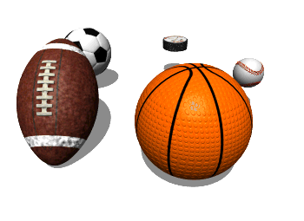
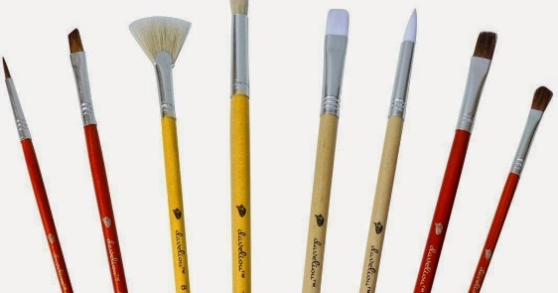
What is Mindset?
“A mental attitude that determines how you will interpret and respond to situations. “
Notes:
How many of you have said something similar at some point? ‘I’m rubbish at maths’ ‘I’m not a sporty person. I’m no good at it’ ‘I’m not at all musical’ ‘I’m no good at art. I can’t draw to save my life!’ ? We often have a belief that we are good or not so good at something. Maybe this relates back to our own school days? We build a belief about ourselves for one reason or another and that in turn determines how we approach certain subjects or situations.

Slide 7
Quiz

Slide 8
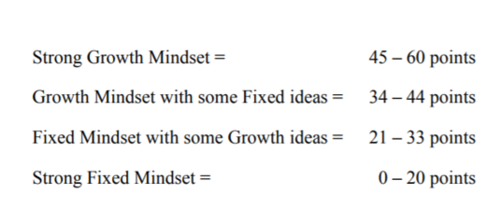
Quiz

Slide 9
Where does your Mindset come from?

Slide 10
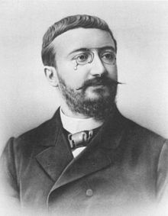
Albert Binet
Goal – to identify students who needed special help in coping with the school curriculum
No matter how much you learn or how hard you work, your intelligence stays the same!
Notes:
No matter how much you learn or how hard you work, your intelligence stays the same!
Alfred Binet was a French psychologist who invented the first practical intelligence test, the Binet-Simon scale. His main goal was to identify students who needed special help in coping with the school curriculum. This led to years of belief that we are born with a fixed level of intelligence.

Slide 11
Years of Common Beliefs
Intelligence is fixed
We are born with a certain level of intelligence or IQ
We are born with talent

Slide 12
Growth Mindset Theory
Intelligence is a quality that can be changed and developed
Notes:
Growth mindset theory aims to change that perception of our beliefs about how we learn. Babies are born motivated to learn. They work hard to develop so many new skills. You don’t see an unmotivated baby, so what happens?

Slide 13
Mindset and Achievement.
Decades of research show a powerful relationship between mindset and achievement
Notes:
Children begin to feel like they are good or not good at something. What about effort? Pupils with a fixed mindset actually see effort as proof of low ability. They think that if you have to try hard that means you aren’t very good at something. They will seek easy options and will avoid challenge as they don’t want to appear not to be able to be successful. This in turn means that achievement over time is lower. They consider asking for help as a negative and also finding something difficult as being a bad thing. Whereas students with a growth mindset are more likely to agree with...
“The harder you work at something, the better you’ll be at it.”

Slide 14
Mindset and Achievement.
Students’ beliefs about intelligence and learning are impacted by:
Motivation
Academic behaviours (e.g. attitudes to studying and seeking help)
Responses to challenges and setbacks
Academic achievement
Notes:
Children begin to feel like they are good or not good at something. What about effort? Pupils with a fixed mindset actually see effort as proof of low ability. They think that if you have to try hard that means you aren’t very good at something. They will seek easy options and will avoid challenge as they don’t want to appear not to be able to be successful. This in turn means that achievement over time is lower. They consider asking for help as a negative and also finding something difficult as being a bad thing. Whereas students with a growth mindset are more likely to agree with...
“The harder you work at something, the better you’ll be at it.”

Slide 15
Learning How to Learn
Response to challenge and setbacks
Attitudes to studying,
seeking help
Motivation

Slide 16
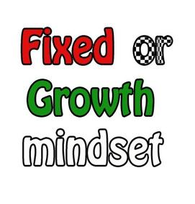
Research
Notes:
Carol Dweck, who pioneered this research, began studying students’ beliefs about intelligence because she was interested in the question of why some students are so resilient in the face of challenges while others are not. What she found was that students generally hold one of two very different beliefs about intelligence. Some students have what she calls a “fixed mindset” - the belief that intelligence is a fixed trait that doesn’t change much. So, like eye color - these students believe you’re born with a certain amount of it and there’s not much you can do to change it. Other students have a very different belief about intelligence - a growth mindset. They see it more like a muscle that grows with effort.

Slide 17
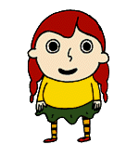
Give up easily
See effort as fruitless
Fixed Mindset
Intelligence is a fixed trait
May achieve less than their full potential
Avoid challenge
Ignore useful negative feedback
Don’t ask for help
Feel threatened by the success of others
Notes:
Children begin to feel like they are good or not good at something. What about effort? Pupils with a fixed mindset actually see effort as proof of low ability. They think that if you have to try hard that means you aren’t very good at something. They will seek easy options and will avoid challenge as they don’t want to appear not to be able to be successful. This in turn means that achievement over time is lower. They consider asking for help as a negative and also finding something difficult as being a bad thing. Whereas students with a growth mindset are more likely to agree with...
“The harder you work at something, the better you’ll be at it.”

Slide 18
Learn from criticism
Growth Mindset
Intelligence grows with effort
Reach ever higher levels of achievement
Embrace
challenge
See effort as the path to mastery
Find lessons and inspiration in the success of others
Persevere despite setbacks
Notes:
Children begin to feel like they are good or not good at something. What about effort? Pupils with a fixed mindset actually see effort as proof of low ability. They think that if you have to try hard that means you aren’t very good at something. They will seek easy options and will avoid challenge as they don’t want to appear not to be able to be successful. This in turn means that achievement over time is lower. They consider asking for help as a negative and also finding something difficult as being a bad thing. Whereas students with a growth mindset are more likely to agree with...
“The harder you work at something, the better you’ll be at it.”

Slide 19
What are we doing at school?
Perseverance
Collaboration
Independence
Marking and feedback
Peer assessment
Challenge
Celebrate success – Good learning
Modelling
Use Growth Mindsets language
Thinking Days

Slide 20
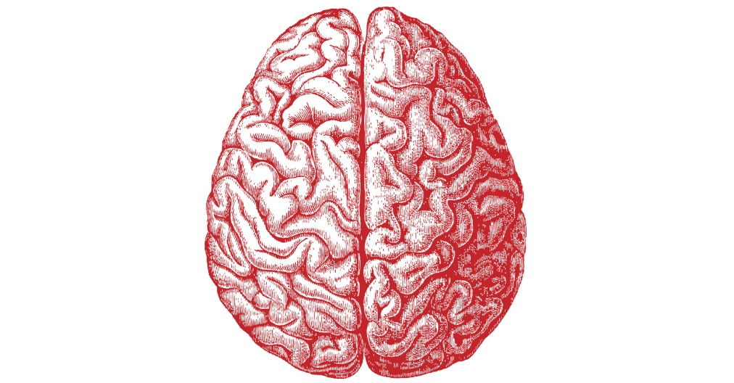
Our Amazing Brains
The Brain Is Malleable
The brain is like a muscle that gets stronger and works better the more it is exercised.
Notes:
If we want to make our muscles stronger we exercise them. We know that we have to work our muscles to strengthen them. This is also true for the brain. Every time we learn something a new neural pathway is created in the brain. The more we practise that skill, the stronger the pathway becomes. Its like walking through field of long grass. The more we tread the same path, the easier the path becomes to follow.

Slide 21
Making new neural pathways….
Notes:
Too often students believe the brain is static, leading them to think talent and giftedness are permanent, unchanging personal attributes that automatically bring later success. However, as we now know, every time you work hard, stretch yourself and learn something new your brain forms new connections and over time you actually become smarter.

Slide 22
The more we tread the same path the easier the path is to follow – you become smarter!

Slide 23
Growth Mindset in Action at John Hampden
Notes:
We strongly believe that Growth Mindset is a powerful tool for developing the best for our children at John Hampden. We want them to develop learning behaviours that they can carry with them through life. This begins in Foundation Stage with the introduction of our challenge superheroes.

Slide 24
Growth Mindset In The Foundation Stage
Language – choosing words carefully
Learning about the Brain
Super Learning Powers
Celebrating Effort
Skills based learning and opportunities to apply learning
Open ended opportunities – no one right way

Slide 25
Language
Becoming aware of what we say and the words we use and the impact this can have on our children
Even very young children quickly pick up on our views and opinions
Children react in different ways to what they hear
Self fulfilled prophecy

Slide 26
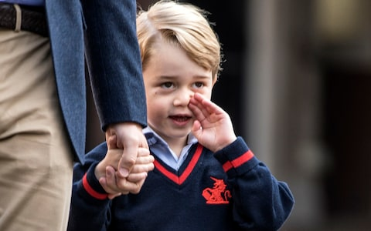
Starting School

Slide 27
On Tuesday….
Prince William told a fellow parent on a visit to Milton Keynes: "I just dropped George off and he didn't want to go."

Slide 28
On Prince George's first day on September 7, the Duke said the new starters had all taken the anxious moment in their stride while it was the parents who were full of nerves.
But he hinted it might not always be plain sailing, saying: "We are all seeing how long that lasts before he doesn't want to go."

Slide 29
Using the Language Of Growth Mindset
“Hold your pencil carefully like this.”
“I like the way you tried different ways to solve that problem.”
“Your brain is built to learn.”

Slide 30
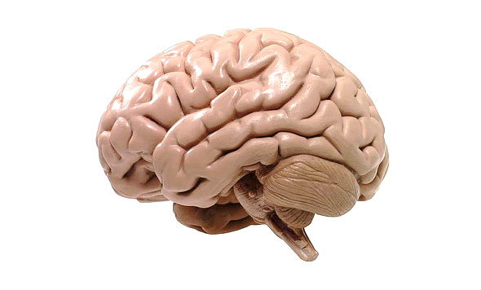
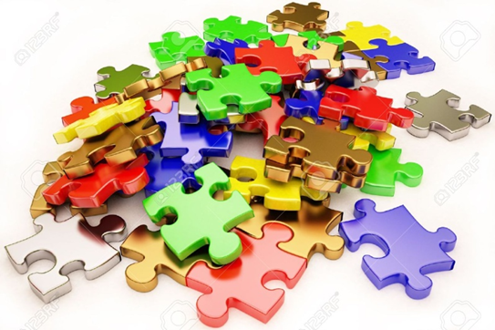
The Brain
What does the brain look like?
How do you exercise your brain?
How do you look after your brain?

Slide 31
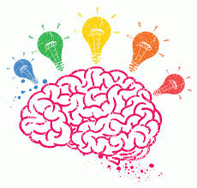
Grow our Brain
Grow our Brain
We all have the ability to grow our brain. We need to challenge ourselves to try out new learning.

Slide 32
Be Positive
To help you grow your brain and learn more you need to be positive.
You need to think I CAN DO IT!
I will try my best.
It is good to make mistakes and learn from them.

Slide 33
Super Learning Powers
Inside us all we have some Super Learning Powers which will help us to grow our brains.
We will meet some superheroes that will help us.

Slide 34
Captain Challenge
I like to explore new learning and challenge myself.
The bigger the challenge the better.
I love challenges- my brain keeps growing
I have lots of Learning Power

Slide 35
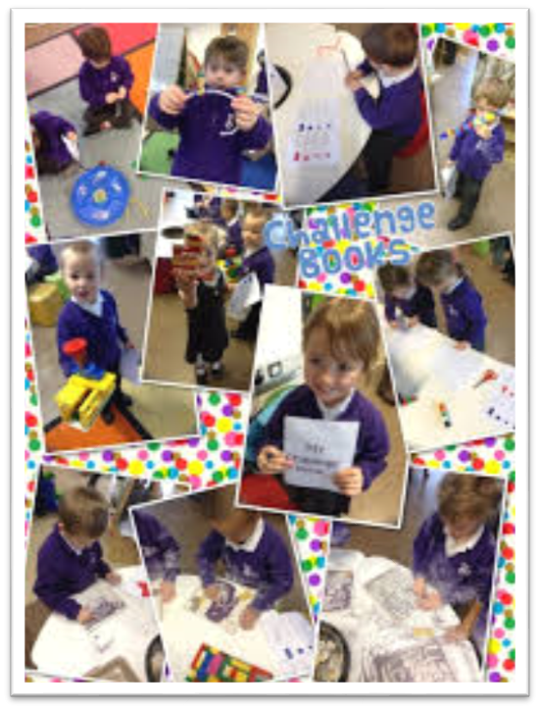
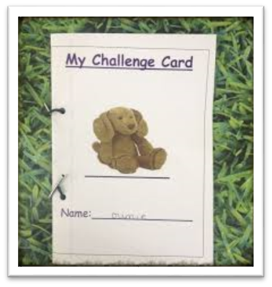
Challenge Books / Cards

Slide 36
Collaboration Kid
Meet Collaboration Kid.
Collaboration Kid works with friends to help grow their brains.
Collaboration Kid enjoys working with others.
Collaboration Kid says “My friends help me to grow my brain. We have fun learning together.”

Slide 37
Professor Persevere
I am determined to keep trying even when it is hard. I can learn from my mistakes.
Can you persevere when things get tricky?

Slide 38
Secret Agent Independence
I can work out what I need and am happy to work independently.
How do you feel when you have done something on your own?

Slide 39
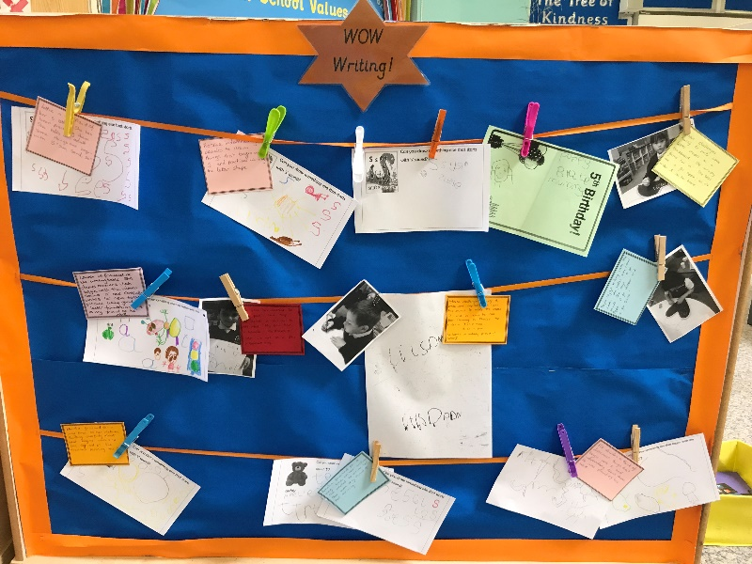
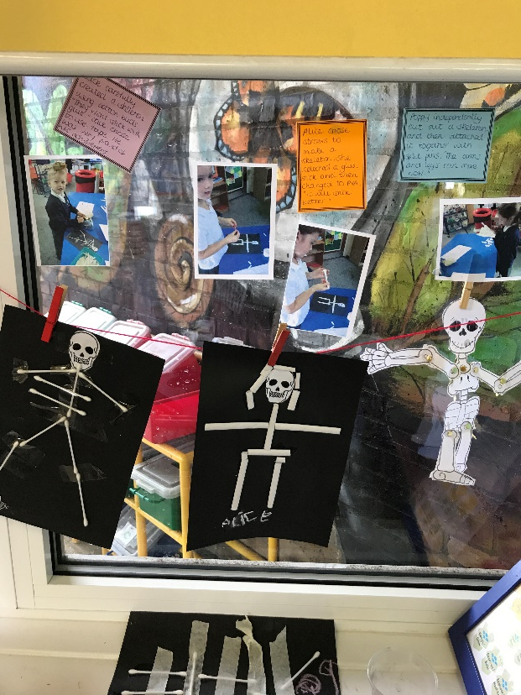
Celebrating Learning

Slide 40
Open ended opportunities

Slide 41
Skills
Area | Skill
Workshop | Joining | High level join – Techniques that involve good fine motor manipulation and master the use of other equipment and techniques to enable them to join Resources: Hole punch, split pins, treasury tags, threading resources (hole punch, wool, string), stitching resources (large blunt ended needles and thread | Mid level join – Techniques and resources that require more advanced dexterity and a wider range of apparatus Resources: Tape, elastic bands, paper clips (large and small), stapler | Basic level join – using easily accessible glue to stick two surfaces together Resources: Glue sticks, PVA, a range of materials with large flat surfaces to make joining easier

Slide 42
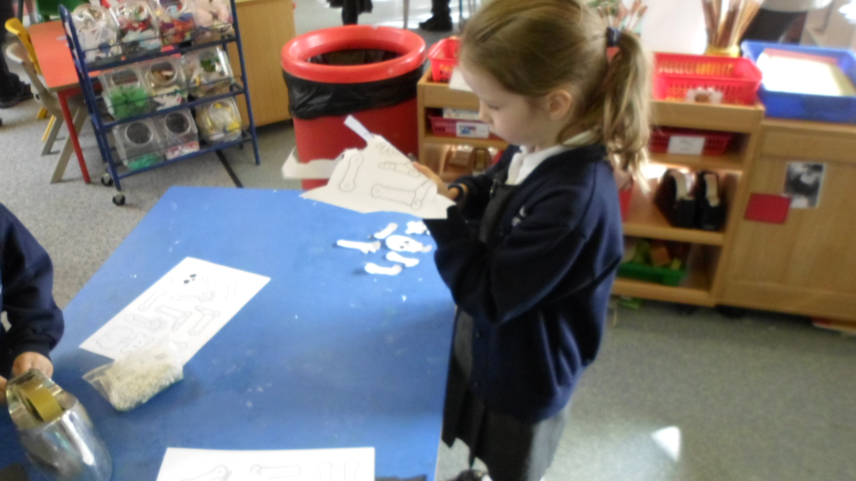
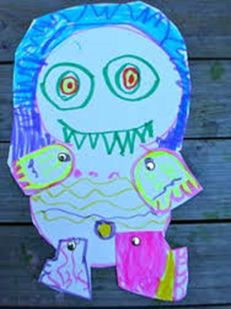
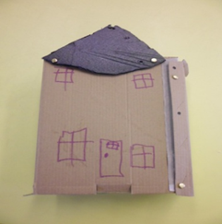
Applying skills….

Slide 43
Growth Mindset In The Foundation Stage
Language – choosing words carefully
Learning about the Brain
Super Learning Powers
Celebrating Effort
Skills based learning and opportunities to apply learning
Open ended opportunities – no one right way

Slide 44
The Little Boy
Once a little boy went to school. He was quite a little boy. And it was quite a big school. But when the little boy Found that he could go to his room By walking right in from the door outside, He was happy. And the school did not seem Quite so big any more.

Slide 45
The Little Boy
One morning, When the little boy had been in school a while, The teacher said: “Today we are going to make a picture.” “Good!” thought the little boy. He liked to make pictures. He could make all kinds: Lions and tigers, Chickens and cows, Trains and boats – And he took out his box of crayons And began to draw.

Slide 46
The Little Boy
But the teacher said: “Wait! It is not time to begin!” And she waited until everyone looked ready.
“Now,” said the teacher, “We are going to make flowers.” “Good!” thought the little boy, He liked to make flowers, And he began to make beautiful ones With his pink and orange and blue crayons.

Slide 47
The Little Boy
But the teacher said, “Wait! And I will show you how.” And she drew a flower on the blackboard. It was red, with a green stem. “There,” said the teacher. “Now you may begin.”

Slide 48
The Little Boy
The little boy looked at the teacher’s flower. Then he looked at his own flower, He liked his flower better than the teacher’s. But he did not say this, He just turned his paper over And made a flower like the teacher’s. It was red, with a green stem.

Slide 49
The Little Boy
On another day, When the little boy had opened The door from the outside all by himself, The teacher said, “Today we are going to make something with clay.” “Good!” thought the boy. He liked clay.

Slide 50
The Little Boy
He could make all kinds of things with clay: Snakes and snowmen, Elephants and mice, Cars and trucks – And he began to pull and pinch His ball of clay.

Slide 51
The Little Boy
But the teacher said, “Wait! And I will show you how.” And she showed everyone how to make One deep dish. “There,” said the teacher. “Now you may begin.”

Slide 52
The Little Boy
The little boy looked at the teacher’s dish Then he looked at his own. He liked his dish better than the teacher’s But he did not say this, He just rolled his clay into a big ball again, And made a dish like the teacher’s. It was a deep dish.

Slide 53
The Little Boy
And pretty soon The little boy learned to wait And to watch, And to make things just like the teacher. And pretty soon He didn’t make things of his own anymore. Then it happened That the little boy and his family Moved to another house, In another city, And the little boy Had to go to another school

Slide 54
The Little Boy
This school was even bigger Than the other one, And there was no door from the outside Into his room. He had to go up some big steps, And walk down a long hall To get to his room.
And the very first day He was there, the teacher said, “Today we are going to make a picture.”

Slide 55
The Little Boy
“Good!” thought the little boy, And he waited for the teacher To tell him what to do But the teacher didn’t say anything. She just walked around the room.
When she came to the little boy, She said, “Don’t you want to make a picture?” “Yes,” said the little boy. “What are we going to make?” “I don’t know until you make it,” said the teacher.

Slide 56
The Little Boy
“How shall I make it?” asked the little boy. “Why, any way you like,” said the teacher. “And any colour?” asked the little boy. “Any colour,” said the teacher, “If everyone made the same picture, And used the same colours, How would I know who made what, “And which was which?” “I don’t know,” said the little boy. And he began to draw a flower. It was red, with a green stem.
~ Helen E. Buckley

Slide 57
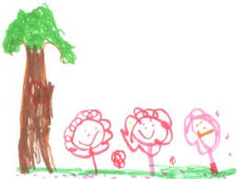
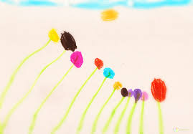
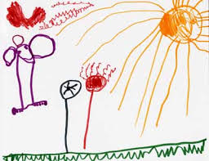
Celebrating Creativity

Slide 58
The Learning Pit
Notes:
The Learning Pit is an idea used by many schools. It shows the stages of learning something new through the idea of a pit. We have to jump into the pit to ome out the other side stronger and more skilled. It encourages the idea that we have to face struggle to learn something new.

Slide 59
Our Amazing Learning Adventure
Notes:
At John Hampden School, we have adapted the Learning Pit to ‘Our Amazing Learning Adventure’ The aim is the same as the pit. We encourage the children to thinking of learning something new as an exciting adventure. At the start we may feel nervous, fearful and worried. We can use our ‘power boost’ to help us along the way. This may be asking for help or simply persevering and not giving up. Once we have been through the power boost phase we can then begin to move forward with a new skill. This is consistent message throughout the school. We are continuing to develop this through assemblies and work in classrooms. However it is not just about how the children approach their learning but how we change our language to encourage this Growth Mindset.

Slide 60
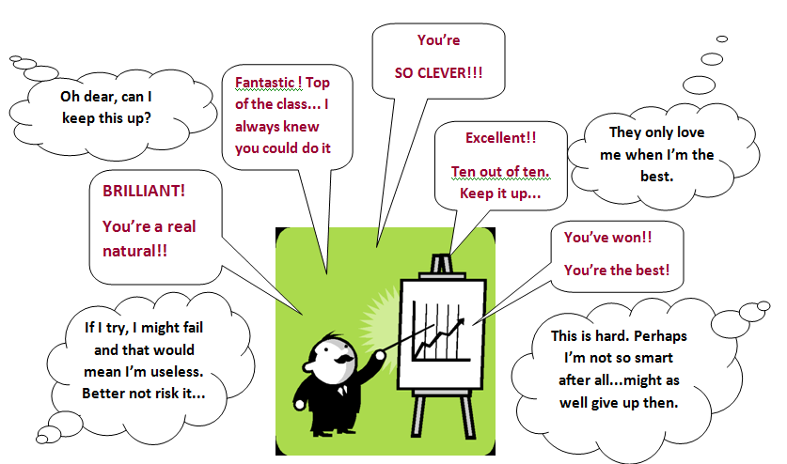
The Language We Use
Notes:
What we say to our children can encourage a fixed or Growth mindset. The statements in purple are ones we often hear. However, we may not have considered how these statements may affect mindset.

Slide 61
The Power of Yet
Notes:
We have shared this with the children. Instead of saying ‘I can’t do it’ We encourage them to say ‘I can’t do it yet’

Slide 62
Sorting Activity
Say this, not that!

Slide 64
Fixed Mindset Growth Mindset

Slide 65
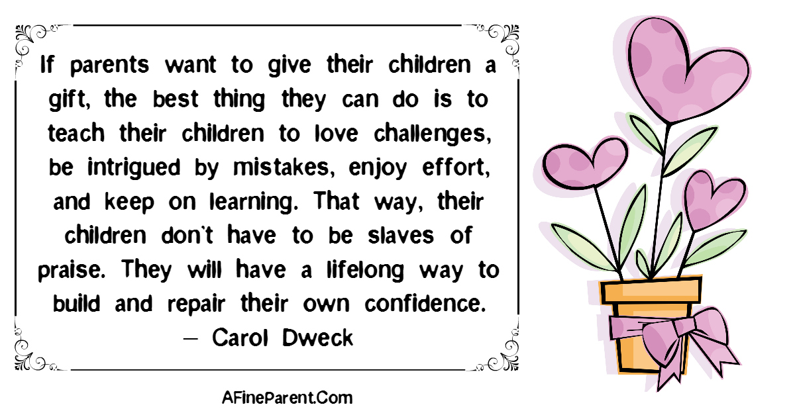

Slide 66
Have we helped you to help us?
Thank you for listening
Feedback Sheet

Slide 67
Sorting Activity
Answers
Growth Mindset
1, 2, 5, 7, 8, 10, 12, 13, 15, 16, 18, 19, 21, 23
Fixed Mindset
3, 4, 6, 9, 11, 14, 17, 20, 22

