Slide 1
Welcome to the
Squirrels
Class

Slide 2
Class teacher:
Mrs Beattie
Teaching assistants:
Mrs Hazel
Mrs Morgan (am)
Mrs Wheeler (pm)

Slide 3
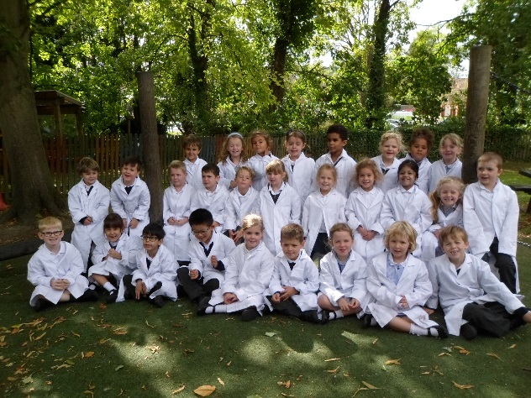
Topics
Science
Our Bodies

Slide 4
Book Changing
Mondays
and
Thursdays.

Slide 5
Home/school Diary
Please sign the diary when
you have heard your child
read.
It can be used to
communicate messages.

Slide 6
Home/school Diary
The smiley faces are for
your child to complete
daily to reflect their day
in school.
Please sign the diary
each week, we will also
sign them weekly.

Slide 7
Homework
Little and often!
Please encourage your
child to read at home on
a daily basis for about 10 minutes.
Practise key words and
spellings regularly.
Homework will
be set fortnightly

Slide 8
P.E.
Tuesday
and Thursday
Please ensure your child
has appropriate kit
and correctly fitting
plimsolls or trainers,
all clearly named.
Long hair tied back and
earrings taped or
removed that day.

Slide 9
Water
Your child can bring
water in a named bottle
to keep in the classroom.
We do not have a water fountain!
Please, only water.
Carried and not brought in
their book bag.

Slide 10
5
Independence
It is lovely to see so
many children entering
the classroom
independently
in the mornings.
Collection from
school
Please let the school know
of any changes to the
collection of your child.

Slide 11
Contact numbers
Please inform the
school if your
contact numbers
change.

Slide 12
Finally
Please do not hesitate
to speak to me if you have
any queries or you
can leave a message
with any of the adults.
Thank you
for coming.

